Slide 1


DEEP COMPRESSION COMPRESSING DEEP NEURAL NETWORKS WITH PRUNING, TRAINED QUANTIZATION AND HUFFMAN CODING
Song Han*, Huizi Mao, William J. Dally
International Conference on Learning Representation (ICLR), 2016
Best Paper Award (ICLR 2016)
Presenters: Darpan Gaur (CO21BTECH11004)
Lakshya Arora (CS24RESCH11006)
Course Instructor : Dr. Rajesh Kedia

Slide 2

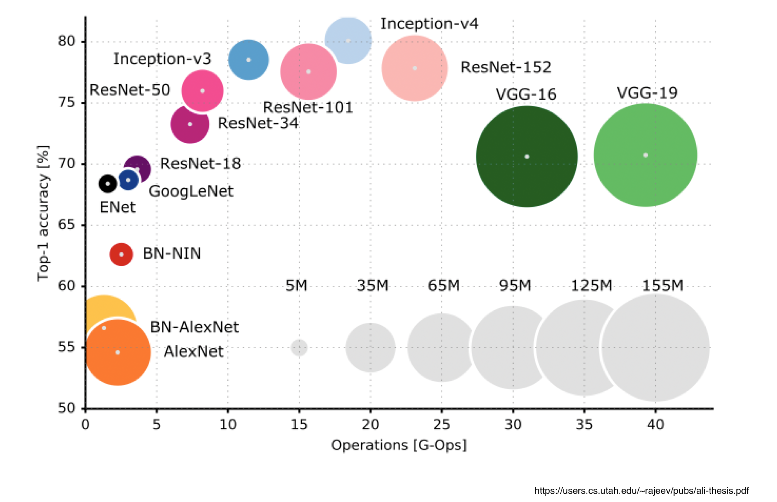


Era of Deep Learning

Slide 3
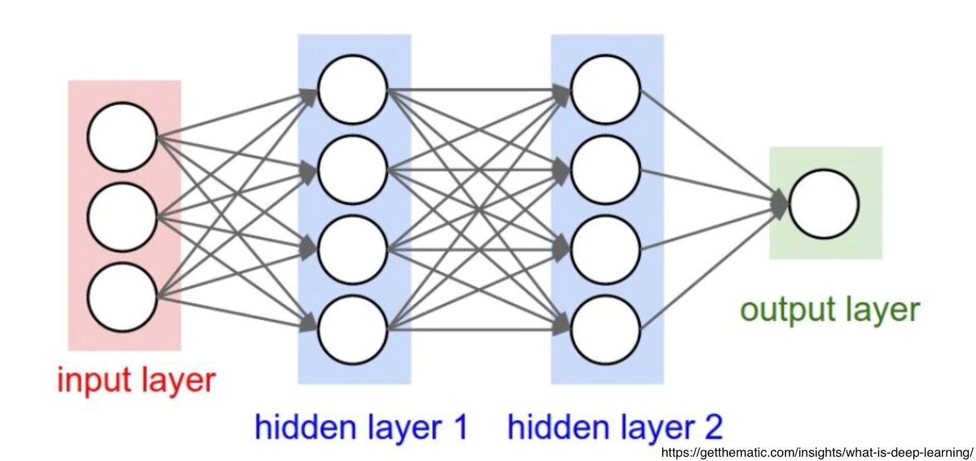
Deep Neural Network
Increasing size of Hidden Layers
Both computationally intensive and memory intensive
High Storage and Energy requirements
Application across Vision, Speech and Text and so on.

Slide 4
Is it possible to run DNN's on Mobile Phones ?

Slide 5

Is it possible to run DNN's on Mobile Phones ?
Limited Storage
Battery and Power Constraint
Limited Hardware Resources
Expensive off-chip (DRAM) memory

Slide 6
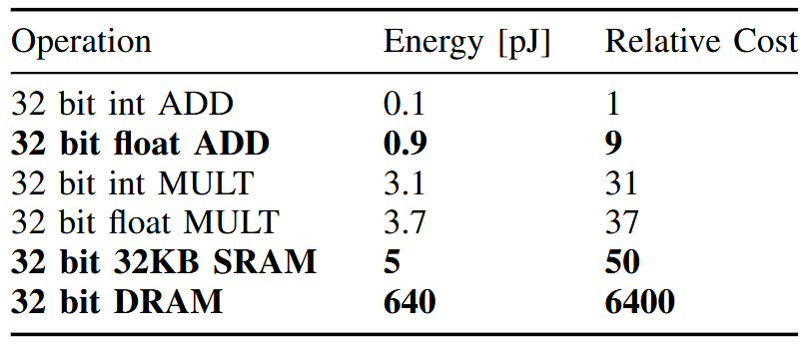
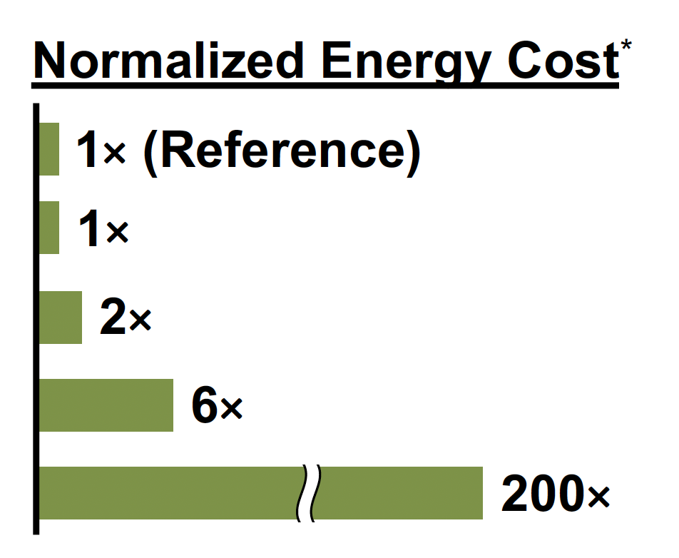
Energy Consumption
20fps would require (20Hz)(1G)(640pJ) = 12.8 W just for DRAM access
(20 Frames/s)x(10^9)x(640pJ/Frame)x(1 Watt/10^12 pJ) = 12.8 W
Han, Song, et al. "EIE: Efficient inference engine on compressed deep neural network." ACM SIGARCH Computer Architecture News 44.3 (2016): 243-254.

Slide 7
Why DNN's on Mobile Phones ?
Better Privacy
Less Network Bandwidth
Real Time Processing

Slide 8
Motivation
DNN’s have millions of parameters
AlexNet: 61M parameters (~240 MB)
VGG-16: 138M parameters (~522 MB)
Deploy DNN's on low-compute environment such as mobile phones and embedded systems.
Reduce storage and energy requirements
Preserving accuracy, and providing speedup
Run inference on mobile devices

Slide 9
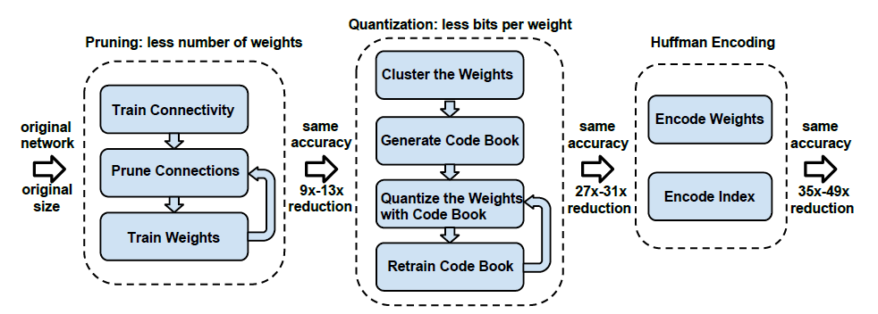
Deep Compression
Three Staged Pipeline
Han S, Mao H, Dally WJ. Deep compression: Compressing deep neural networks with pruning, trained quantization and huffman coding. arXiv preprint arXiv: 1510.00149.

Slide 10
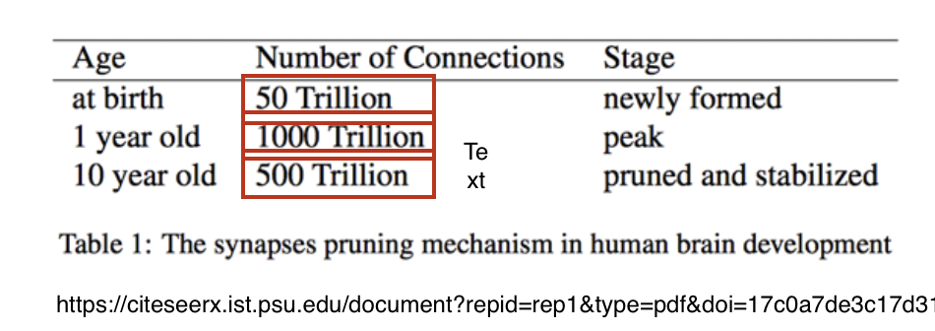
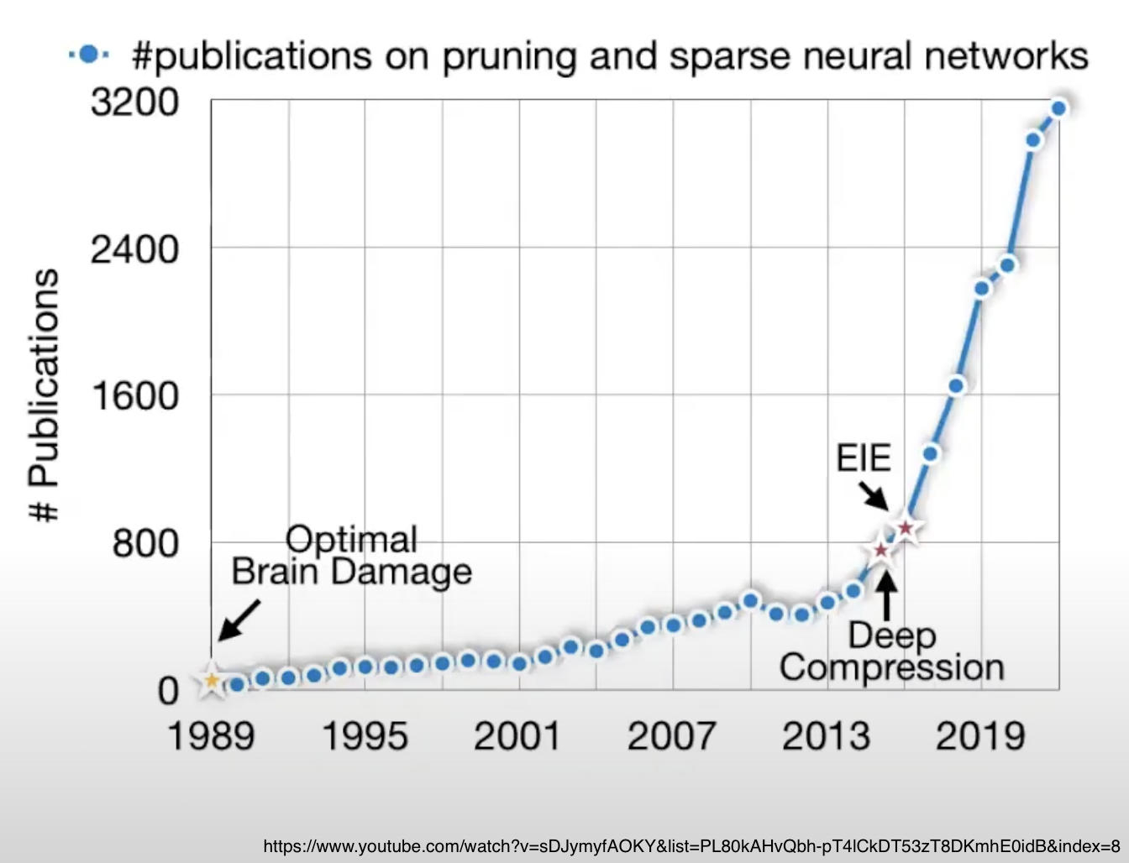
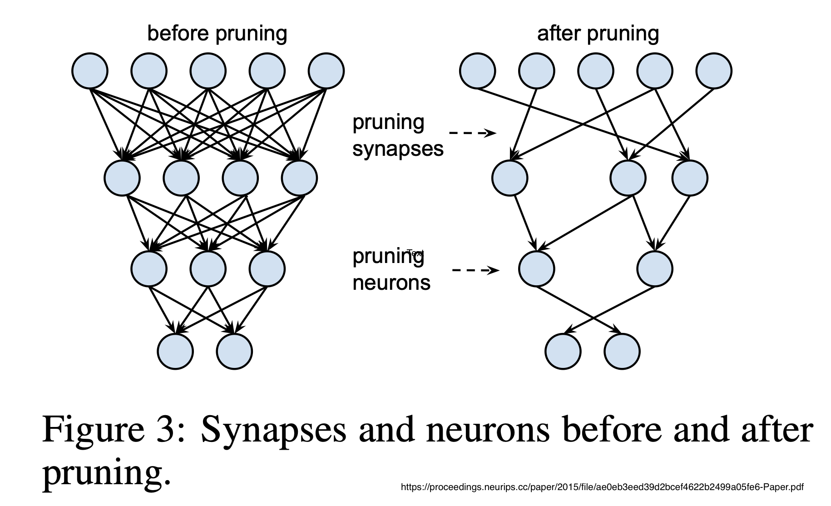
Pruning : Overview

Slide 11
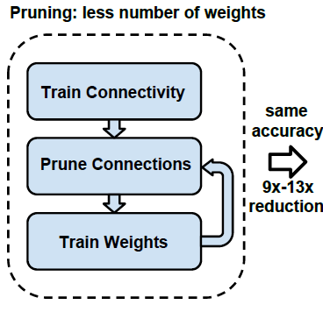
Pruning
Learning the connectivity via normal network training
Connections with weights below a threshold are removed from the network.
Retrain the intermediate network to learn the final weights for the remaining sparse connections.

Slide 12
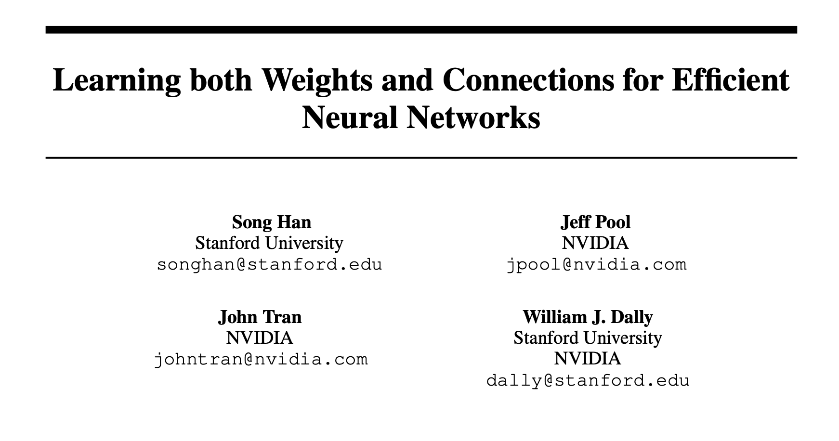
We build on top of this Approach:
Han et al. NeurIPS 2015

Slide 13
Learning both Weights and Connections for Efficient Neural Networks Han et al. 2015
Section 3.1 Regularization -
Control model complexity and prevent overfitting
Choosing correct regularization impacts the performance of pruning and retraining
L1 regularization leads to more parameters near zero, making pruning more effective before retraining
but L2 regularization preserves better connections, leading to higher accuracy after retraining
Section 3.2 Dropout Ratio Adjustment -
Dropout - Prevent Overfitting, also applied to Retraining
In dropout, parameter probabilistically dropped during training
Pruning permanently removes parameters, reducing model capacity
Thus, Dropout Rate during retraining should be lower to avoid excessive regularization.
A formula is provided to adjust the dropout rate accordingly:

Slide 14
Section 3.3 Local Pruning and Parameter Co-adaptation -
Retain Surviving Weights → Avoids losing learned features, ensures better retraining performance
Re-initializing pruned layers disrupts dependencies, makes it harder for model to recover
Retaining weights and selectively retraining layers improves accuracy and efficiency
Only pruned layers are retrained
Section 3.4 Iterative Pruning -
Pruning and retraining performed iteratively
Iterative pruning outperforms aggressive single-step pruning.
Finds the minimum required connections without losing accuracy.
Section 3.5 Pruning Neurons - (This is out of scope of Deep Compression)

Slide 15
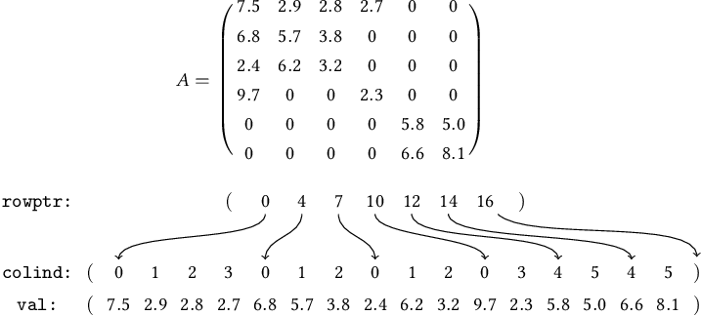
Storage format
The sparse structure from pruning is stored using Compressed Sparse Row/Column (CSR/CSC) optimizing memory usage.
2a+n+1 numbers, where a is the number of non-zero elements and n is the number of rows or columns.
CSR sparse matrix storage format
Elafrou A, Goumas G, Koziris N. A lightweight optimization selection method for Sparse Matrix-Vector Multiplication. arXiv preprint arXiv:1511.02494.

Slide 16
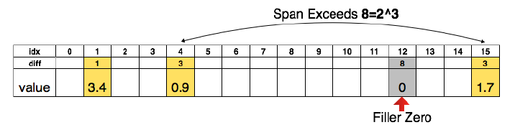
Storage format
Store the index difference instead of the absolute position.
Encode this difference in 8 bits for conv layer and 5 bits for fc layer.
Index difference – difference between consecutive non-zero indices
Han S, Mao H, Dally WJ. Deep compression: Compressing deep neural networks with pruning, trained quantization and huffman coding. arXiv preprint arXiv: 1510.00149.

Slide 17
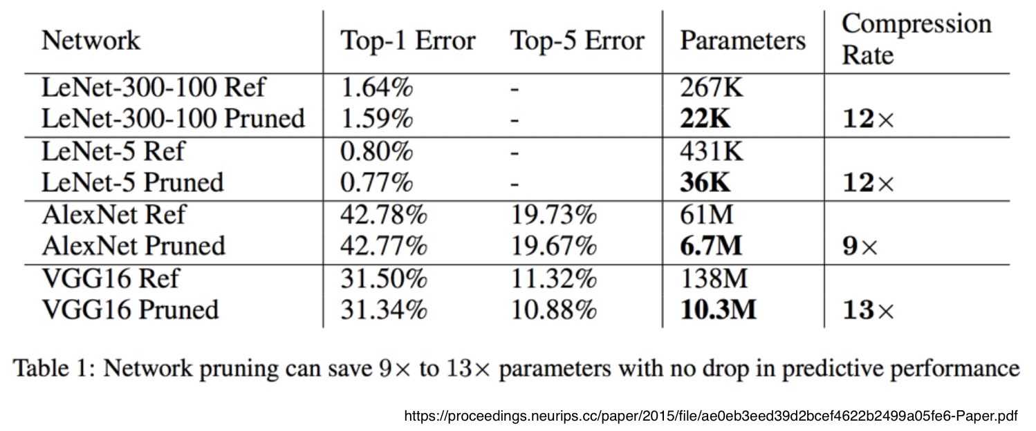
Pruning Results : -

Slide 18
DEEP COMPRESSION ICLR 2016 (Song Han)
Learning both Weights and Connections for Efficient Neural Networks​ NeurIPS 2015 (Song Han)
Iterative Pruning
( Pruning + Fine-Tuning )
without incurring accuracy loss + CSR/CSC Storage Format further compression (8 bits for CONV, 5 bits for FC)
Iterative Pruning
( Pruning + Fine-Tuning )
without incurring accuracy loss

Slide 19
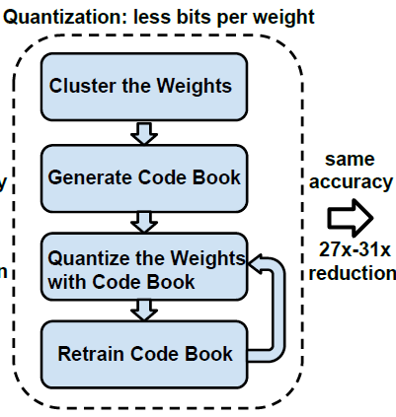
Quantization
Reduce number of bits to represent each weight.
Limit the number of effective/unique weight.
To Achieve low bit-width operation and low storage

Slide 20
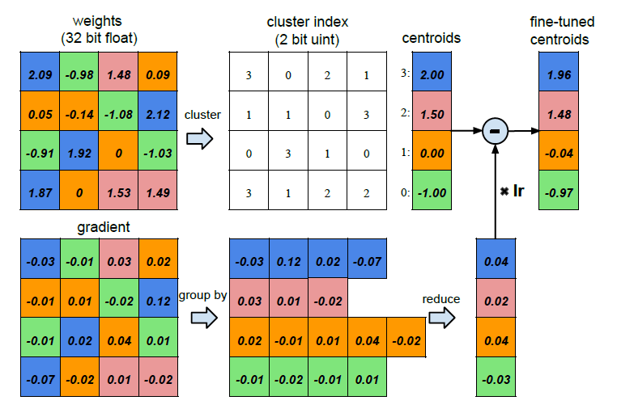
Weight Sharing (Trained Quantization)
In Deep Learning, we don’t need that high precision.
Reducing the precision doesn't hurt accuracy.
STORAGE – Floating Point Weights
COMPUTATION – Floating Point ​Arithmetic

Slide 21
Weight Sharing (Trained Quantization)​

Slide 22

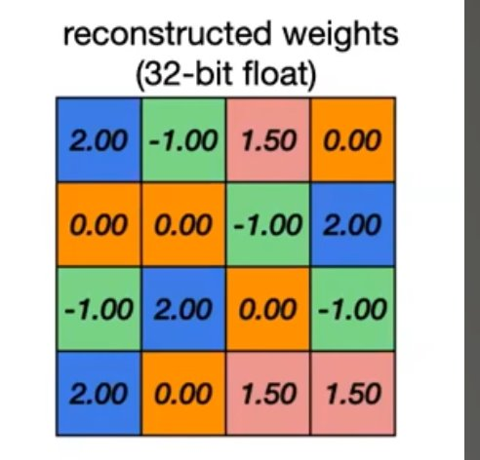
Weight Sharing (Trained Quantization)​​

Slide 23
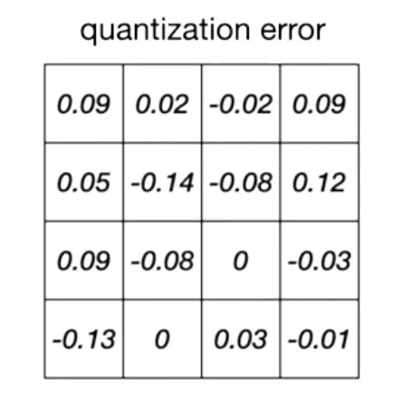
Weight Sharing (Trained Quantization)
Indexes
Codebook (effective wt)
STORAGE:
32 bit * 16 =512b
= 64 B
2 bit * 16 = 32b
= 4 B
32 bit * 4 = 128b
= 16 B
Total Storage = 20 B
3.2x smaller
Quantization Error = Reconstructed weights – Actual weights

Slide 24
Weight Sharing (Trained Quantization)
Indexes
Codebook
(effective wt)
As # weights increases, size of Codebook becomes negligible.
Assume N–bit quantization, # weights = M >>> 2^N
N bit * M
= NM bits
32 bit * M
= 32 M bits
32 / Nx smaller

Slide 25

Weight Sharing (Trained Quantization)​​

Slide 26
Weight Sharing (Trained Quantization)​​

Slide 27
Weight Sharing (Trained Quantization)​​

Slide 28
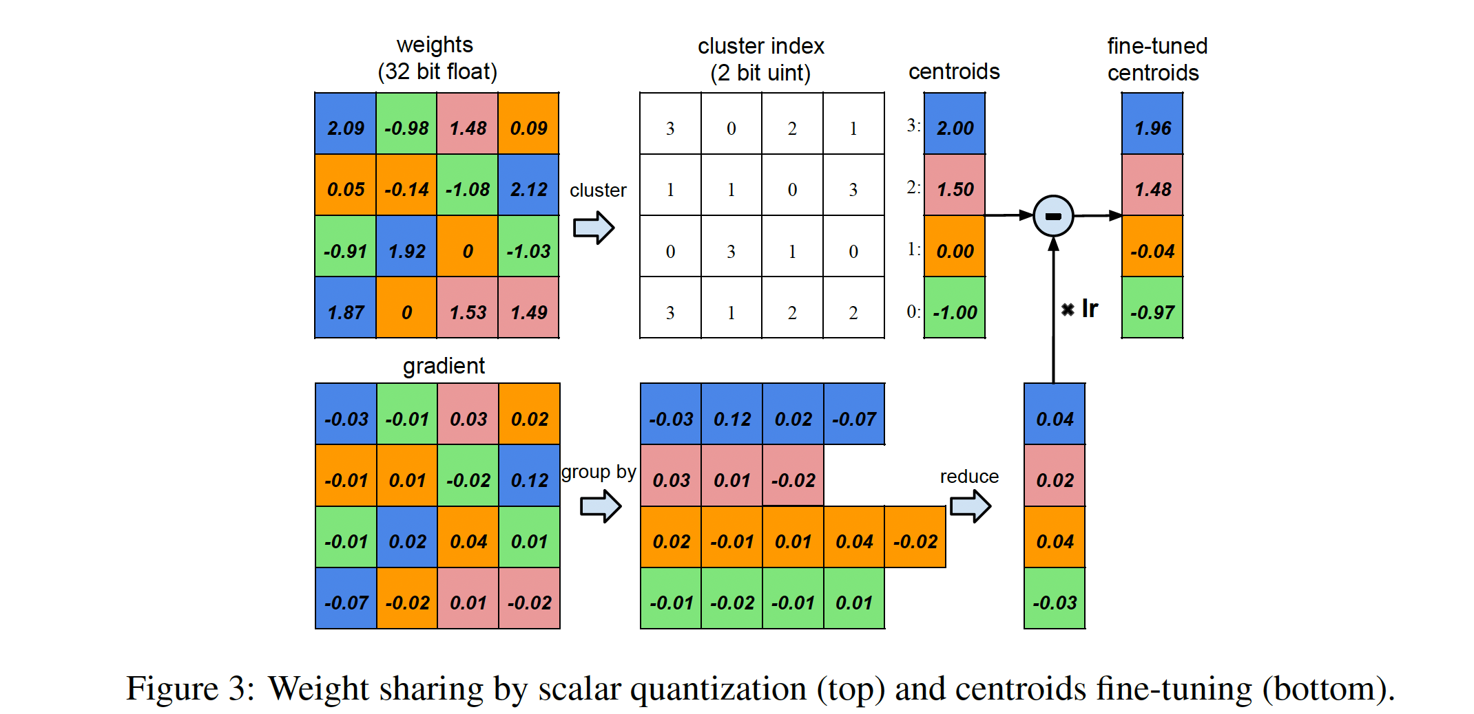
Weight Sharing (Trained Quantization)

Slide 29
Weight Sharing (Trained Quantization)
Fine-Tuning Effective Weights: -
Shared weights are fine-tuned by adjusting centroids based on gradients.
Gradients from all weights mapped to same centroids (same color bin) grouped and aggregated.
Centroid is updated (SGD update). Helps recover accuracy loss from k-Means Clustering.
Fine-Tuned Centroids = Shared Centroids – lr * (summed_grad)
lr – learning rate

Slide 30
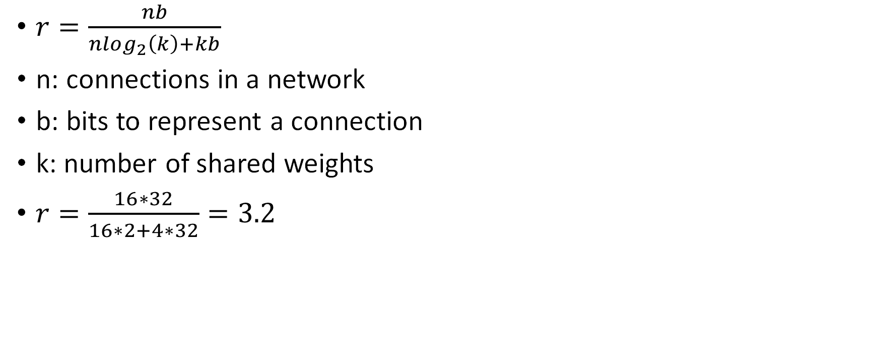
Compression rate
$r=\frac{nb}{nlog_{2}\left(k\right)+kb}$
n: connections in a network
b: bits to represent a connection
k: number of shared weights
$r=\frac{16∗32}{16∗2+4∗32}=3.2$

Slide 31
Initialization of shared weights
Centroid Initialization impacts the quality of clustering and thus affects network's accuracy.
Three methods of centroid initialization explored: -
Forgery:
Randomly choose k points from data as centroids
Density-based:
Centroids denser arounds peaks
Linear:
Linearly spaces the centroids between [min,max] of original weights.
Invariant to distribution of weights.

Slide 32
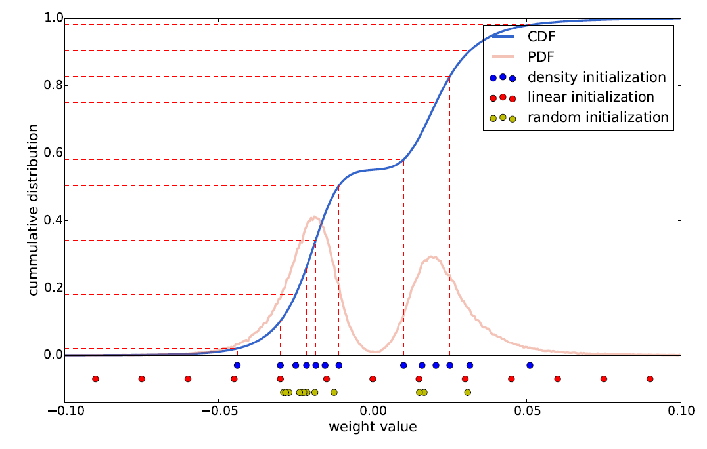
Initialization of weights
Han S, Mao H, Dally WJ. Deep compression: Compressing deep neural networks with pruning, trained quantization and huffman coding. arXiv preprint arXiv: 1510.00149.

Slide 33
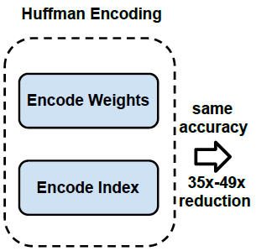
Huffman Coding
Used for lossless data compression.
Variable length codewords to encode symbols.
Frequent weights: use less bits
In-frequent weights: use more bits

Slide 34
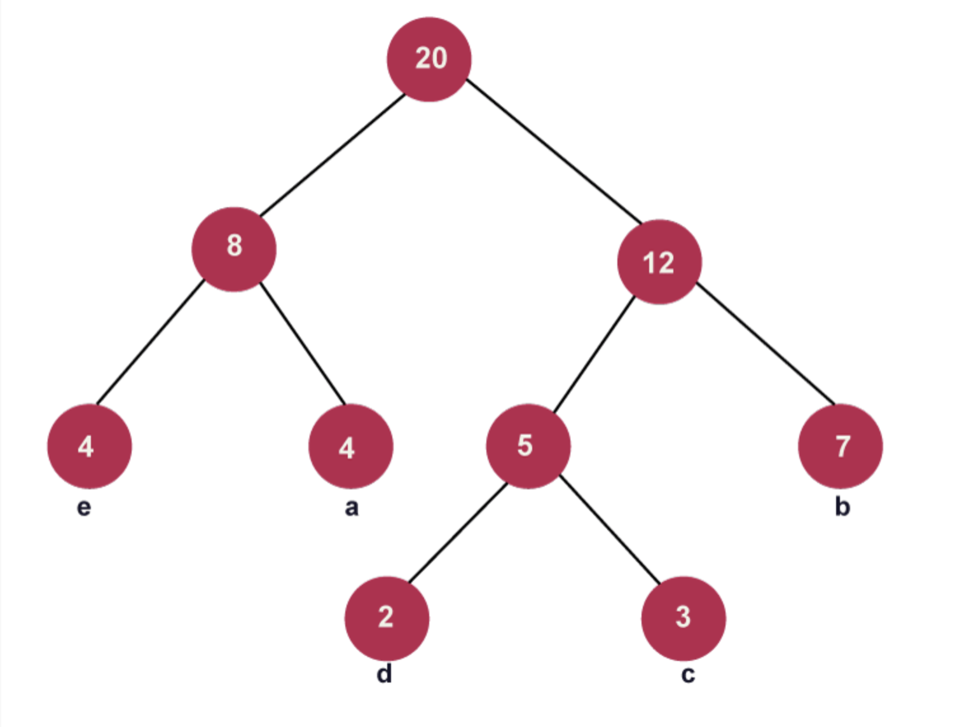
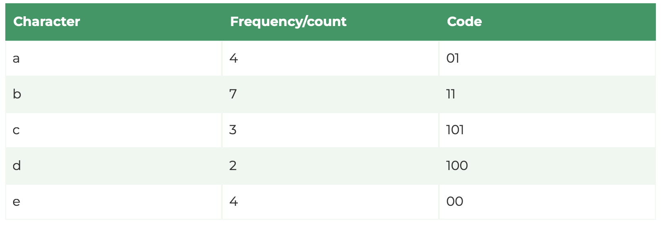
Huffman Coding: Example
https://www.tpointtech.com/huffman-coding-algorithm

Slide 35
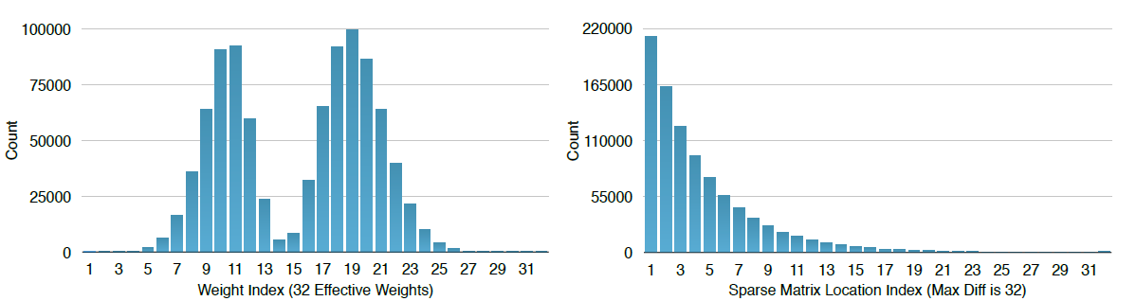
Distribution for weight and index
Both distributions are biased: most of the quantized weights are distributed around the two peaks; the sparse matrix index difference are rarely above 20.
Experiments show that Huffman coding these non-uniformly distributed values saves 20% - 30% of network storage.

Slide 36
Final takeaway:
Pruning – removes redundant weights
Weight Sharing – reduces number of unique weights
Quantization – replaces 32-bit FP with low bit-width representation (8 bit - CONV, 5 bit - FC)
Huffman Coding – assign less bits to frequent weights
Together, all these techniques achieves 35x – 49x compression while maintaining accuracy.

Slide 37
Experiments
MNIST Dataset
LeNet-5
Two convolution layers
Two fully connected layers
LeNet-300-100
Fully connected network with two hidden layers
with 300 and 100 neurons each
ImageNet Dataset
AlexNet
VGG-16

Slide 38
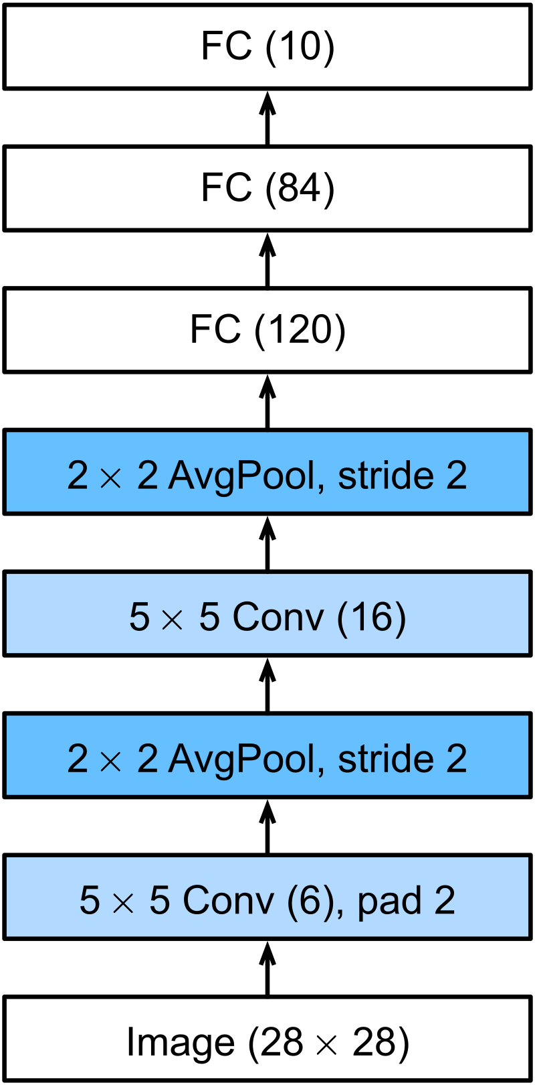
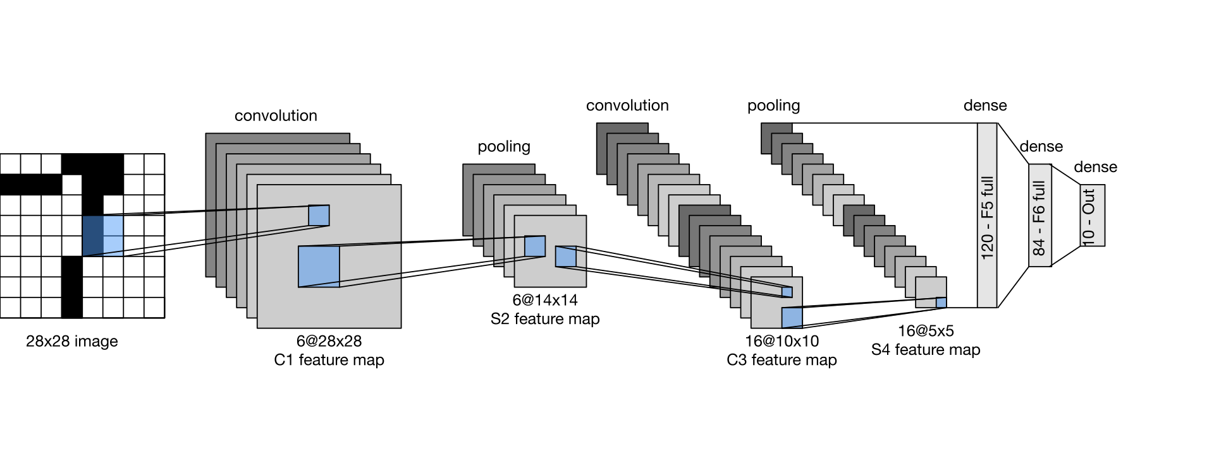
LeNet-5
https://en.wikipedia.org/wiki/LeNet

Slide 39
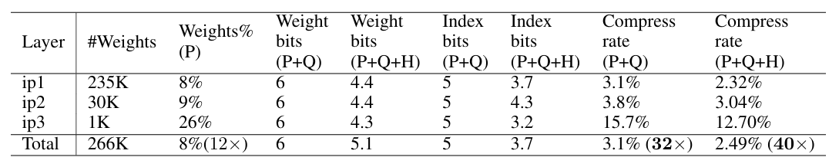
Experiments
Compression statistics for LeNet-300-100
Han S, Mao H, Dally WJ. Deep compression: Compressing deep neural networks with pruning, trained quantization and huffman coding. arXiv preprint arXiv: 1510.00149.

Slide 40
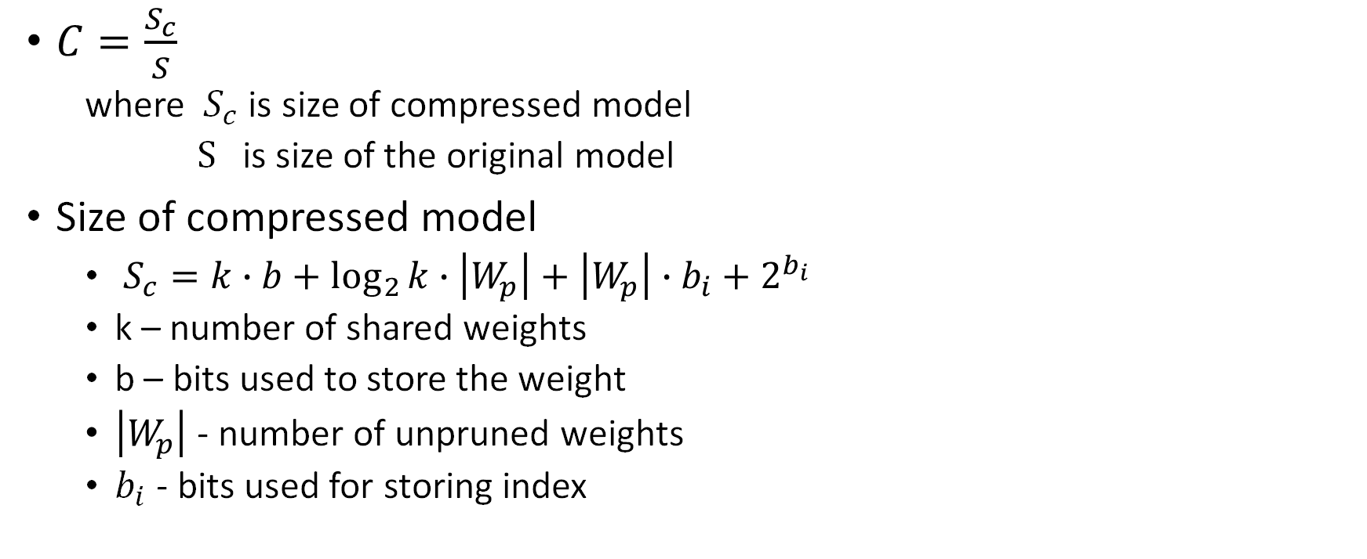
Compression
$C=\frac{S_{c}}{S}$
where $S_{c}$ is size of compressed model
$S$ is size of the original model
Size of compressed model
$S_{c}=k∙b+\log_{2}{k}∙\left|W_{p}\right|+\left|W_{p}\right|∙b_{i}+2^{b_{i}}$
k – number of shared weights
b – bits used to store the weight
$\left|W_{p}\right|$ - number of unpruned weights
$b_{i}$ - bits used for storing index

Slide 41
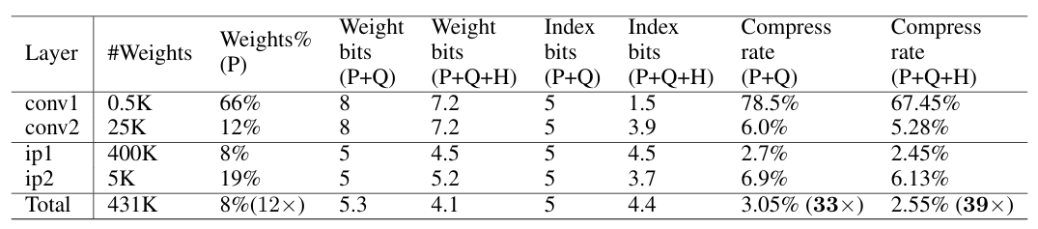
Experiments
Compression statistics for LeNet-5
Han S, Mao H, Dally WJ. Deep compression: Compressing deep neural networks with pruning, trained quantization and huffman coding. arXiv preprint arXiv: 1510.00149.

Slide 42
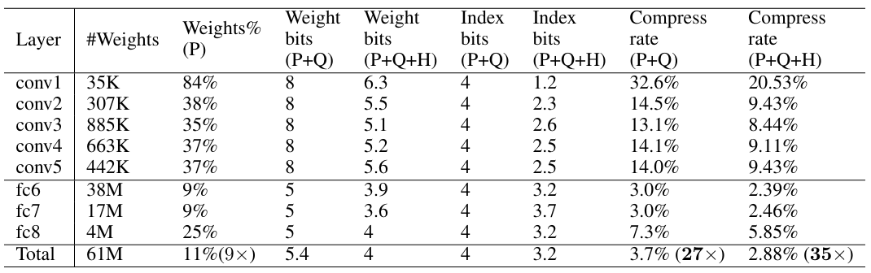
Experiments
Compression statistics for AlexNet
Han S, Mao H, Dally WJ. Deep compression: Compressing deep neural networks with pruning, trained quantization and huffman coding. arXiv preprint arXiv: 1510.00149.

Slide 43
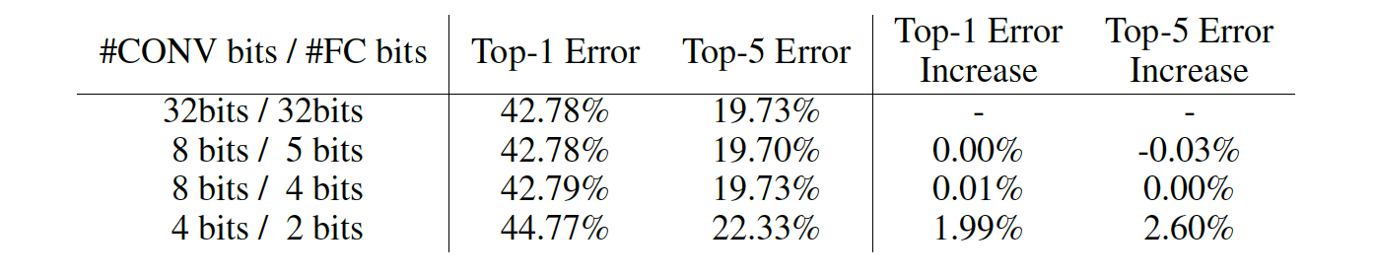
Weight Sharing and Quantization
Han S, Mao H, Dally WJ. Deep compression: Compressing deep neural networks with pruning, trained quantization and huffman coding. arXiv preprint arXiv: 1510.00149.

Slide 44
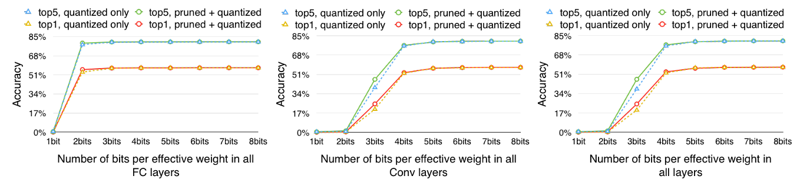
Pruning and Quantization together
Han S, Mao H, Dally WJ. Deep compression: Compressing deep neural networks with pruning, trained quantization and huffman coding. arXiv preprint arXiv: 1510.00149.

Slide 45
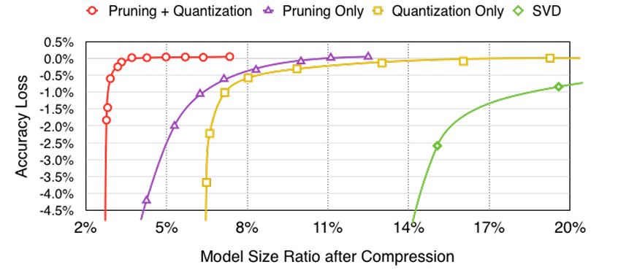
Pruning and Quantization together
Han S, Mao H, Dally WJ. Deep compression: Compressing deep neural networks with pruning, trained quantization and huffman coding. arXiv preprint arXiv: 1510.00149.

Slide 46
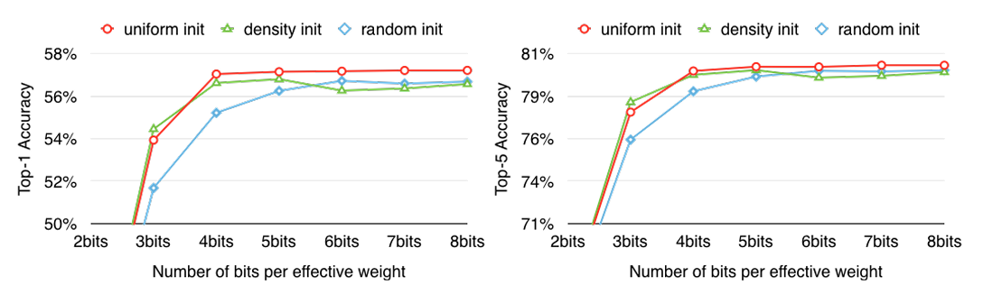
Centroid Initialization
Han S, Mao H, Dally WJ. Deep compression: Compressing deep neural networks with pruning, trained quantization and huffman coding. arXiv preprint arXiv: 1510.00149.

Slide 47
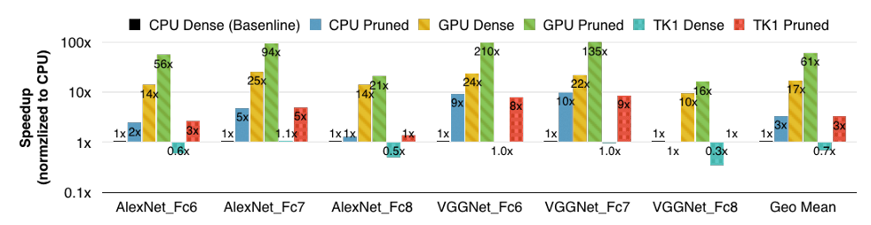
Speedup
Han S, Mao H, Dally WJ. Deep compression: Compressing deep neural networks with pruning, trained quantization and huffman coding. arXiv preprint arXiv: 1510.00149.

Slide 48
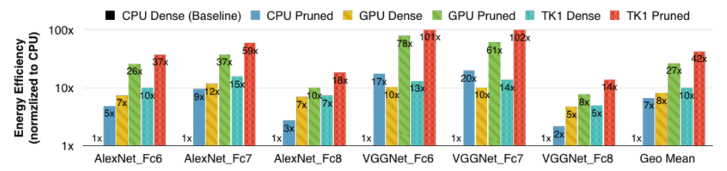
Energy Efficiency

Slide 49
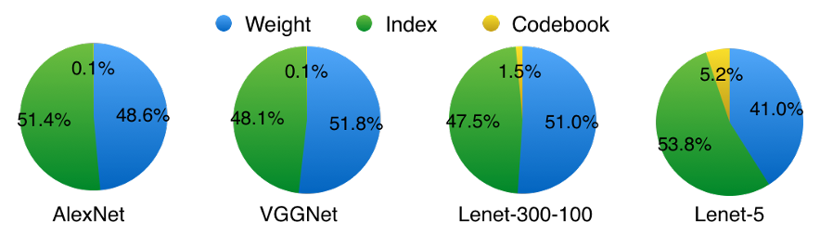
Storage ratio
Storage ratio of weight, index and codebook
Han S, Mao H, Dally WJ. Deep compression: Compressing deep neural networks with pruning, trained quantization and huffman coding. arXiv preprint arXiv: 1510.00149.

Slide 50
Conclusion
Three staged pipeline
Pruning
Quantization
Huffman coding
Compressed DNN without affecting accuracy
Compressed DNN fits onto on-chip SRAM cache
Speedup: 3x to 4x [batch size = 1]
Energy efficient: 3x to 7x less energy [batch size = 1]

